Slide 1
Week 6
SQL

Slide 2
How to get data into a database
You can import a number of different types of files including text, but CSV files are commonly used
Imports can also happen from other programs including spreadsheet programs or other database programs
If you're using SQL you can use a create table or insert command to get your data into your database
There are also some Graphical options depending on the database type you're using
You can also write a script to enter in your data

Slide 3
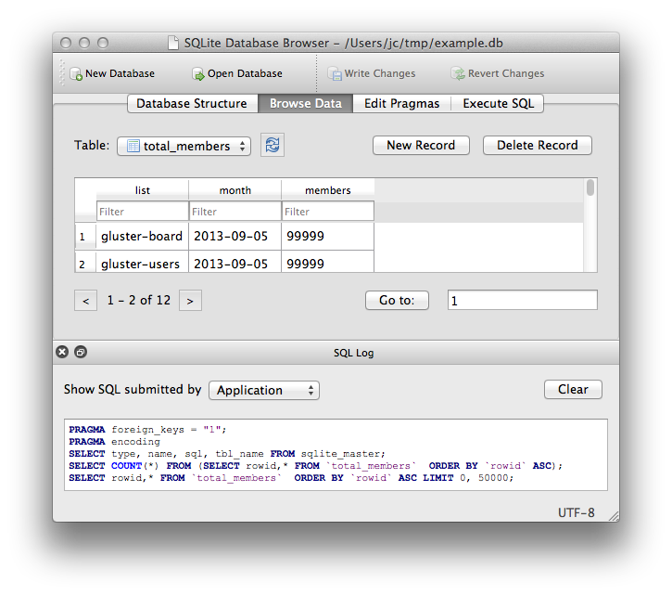
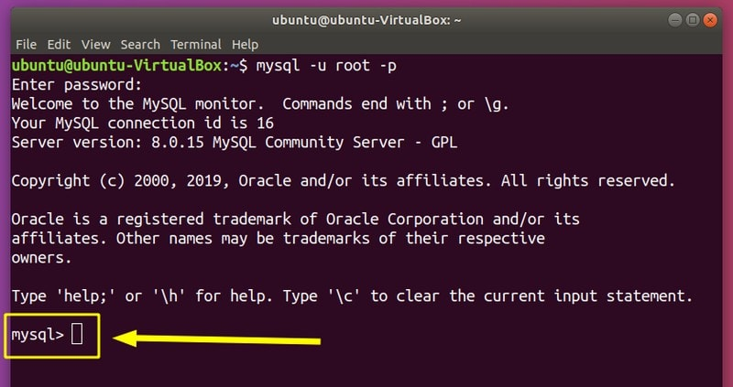
How databases look different on different systems
Databases can be access by either Graphical User Interface (GUI) or Command line
The system you're using will affect how the data is stored and where it's being used
https://itsfoss.com/basic-sql-commands/
https://sqlitebrowser.org/

Slide 4
Different between how the data is stored and how it's accessed
You can have many different front end options
There are a lot of GUI options that can look very different
Each may have different steps used for each thing you want to do
Dashboards are also commonly used for people that need to see but not change the data
Databases will save the information on your computer but that will depend on what database is installed, which can be different then the front end used
Databases can also be on servers and in the cloud, the front end would connect to those for viewing
Generally only a few people may change the data, but many more will be able to see the data

Slide 5
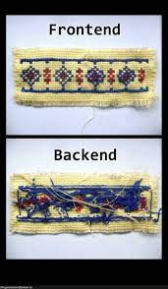
Examples of front ends
You can build your own, but a lot of people use already made options
Your front end can be as simple or complex as you like, some are free, some are not.
Some database front end options can be very complex and include data analytics and visualizations, examples include Tableau, MS Power BI, Oracle Analytics Cloud and AIMMS

Slide 6

Data Dictionary
A data dictionary is an explanation of the data saves in our database.
Should be centralized so everyone using the database is seeing the same definitions.
Clarity can be an issue
Names listed aren't always obvious, and descriptions can be lacking
Active dictionaries are created within the database and auto updated, passive are separate and must be updated manually
https://dataedo.com/cartoon/glossary-or-dictionary

Slide 7
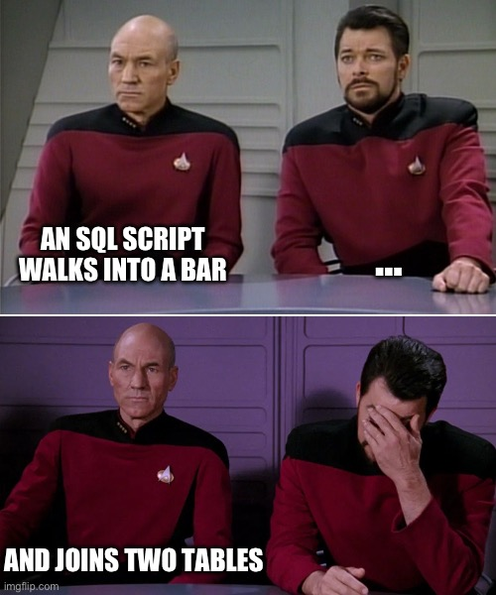
What is SQL
SQL or Structured Query Language is how we can interact with our database
SQL can be used to view, organize and manage the data
SQL commands or queries are done on the command prompt and look similar to command line commands
SQL is relatively human readable once you're used to the syntax
Scripts can be written to automate things and make queries more efficient to use

Slide 8
Why it's so popular
SQL is interactive, so you can see your results pretty fast and make sure you're looking at the right info
It's close enough to programming a lot of developers are very comfortable learning it quickly
Because it's popular a lot of people learn and use it, therefore making it more popular
SQL is relatively dependable and has been in use so long a lot of people have done a lot of testing on it
Once it's setup correctly a company is unlikely to move away into a new technology
Because SQL is relatively human readable a lot of people use it in companies including marketing, QA and sales, some larger companies will even offer free courses for people to learn it

Slide 9
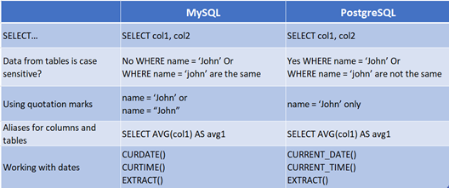
SQL the Brand
SQL was standardized in the 80s, but there are different dialects depending on what database you're using
SQL server is proprietary and owned by MS
Dialects including PostgreSQL and SQLite
For example PostgreSQL is open source and for Object oriented databases (we've been talking about relational), and can also suppose JSON data types
https://christy-g-lee.medium.com/sql-dialects-postgresql-vs-mysql-fb9c15eef7fb

Slide 10
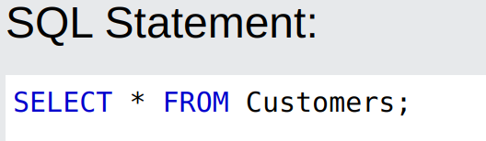
Breakdown of a basic query
For right now we're just using basic SQL standard
Each table in our database will have fields, each record will have a row and column. We need to know what we want to look at to form our query properly
Each SQL query is going to start and include commands such as SELECT, UPDATE, INSERT and DELETE
You want to figure out what you want first, and then try and translate it into a query. For example if you want to look at all customers in your database you might say "SELECT * FROM Customers;"
SELECT is saying what you want
The * indicates you want everything
FROM is where you're getting the info
Customers is the table we're pulling from

Slide 11
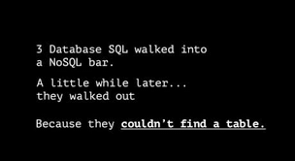
Activity: Try Basic query
If you are a beginner and have never seen SQL and are not comfortable programming try https://www.w3schools.com/sql/sql_syntax.asp and see some examples, and try your own
If you want more of a challenge try the Adventure Island! Or one of the other challenges:
http://wwwlgis.informatik.uni-kl.de/extra/game/?lang=en
https://sqlpd.com/

